Slide 1
Real-time Stabilization and 3D Reconstruction of Hand Gestures and Finger Movement Traces Using LED-Equipped Gloves
Presented by Team 5: Deniz Acikbas, Soham Naik, Zaynab Mourtada, Alan Raj

Slide 2
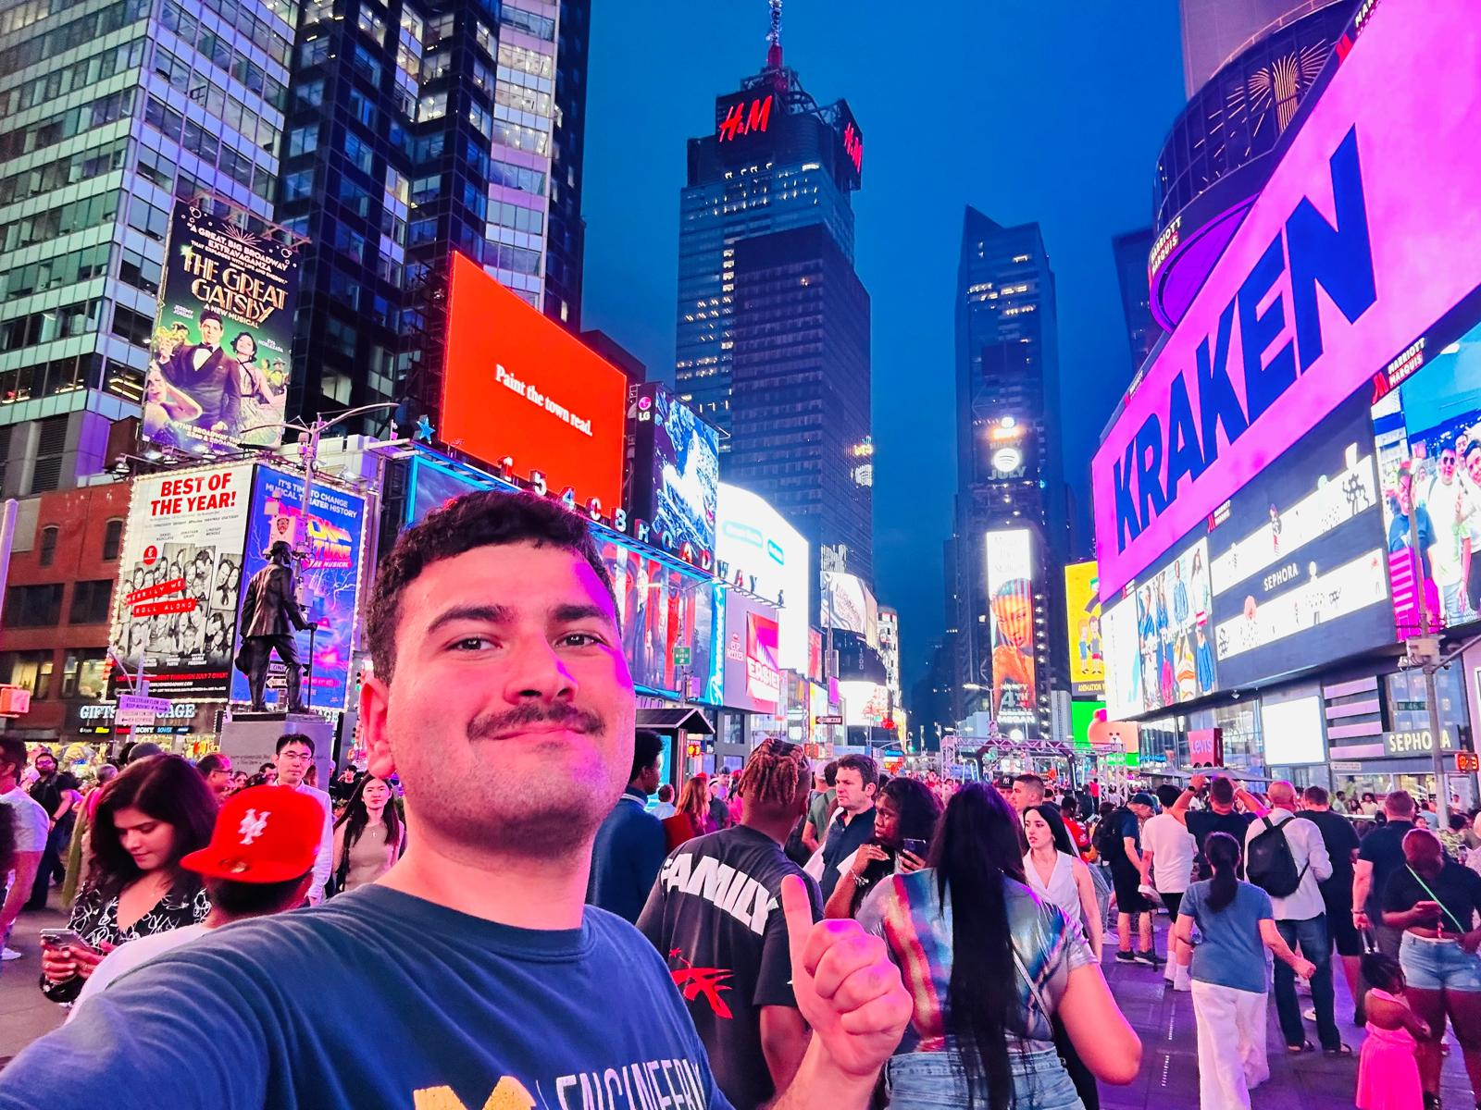
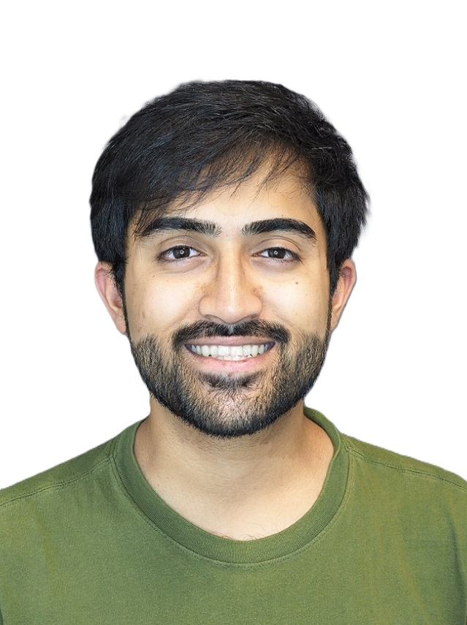
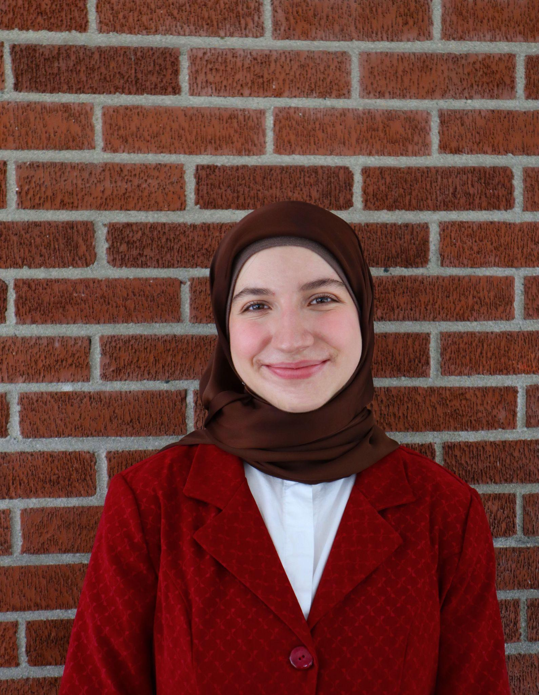
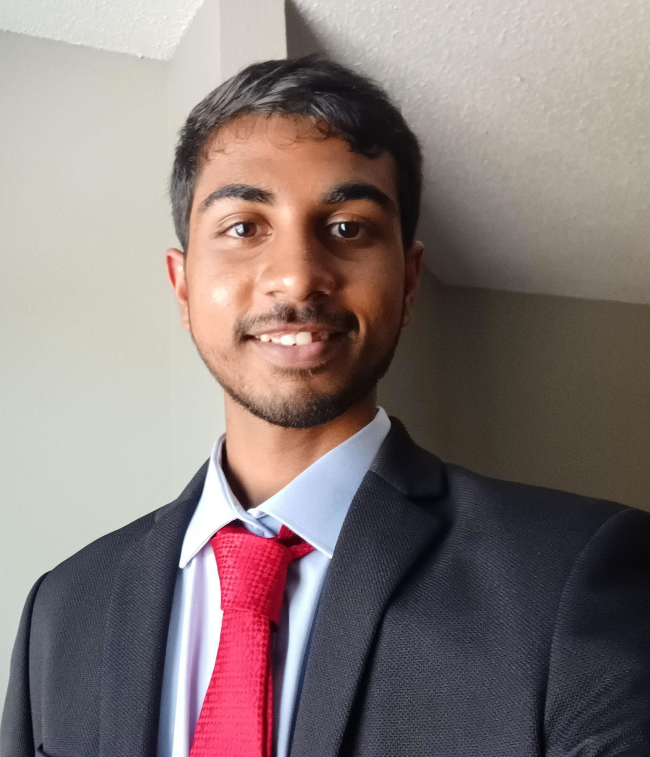
Team Member Roles
Soham Naik
Deniz Acikbas
Lead Mobile App & VR/AR Engineer
Lead Image Processing & Computer Vision Engineer
Zaynab Mourtada
Alan Raj
Lead Machine Learning Engineer
Lead 3D Visualizing
Engineer

Slide 3
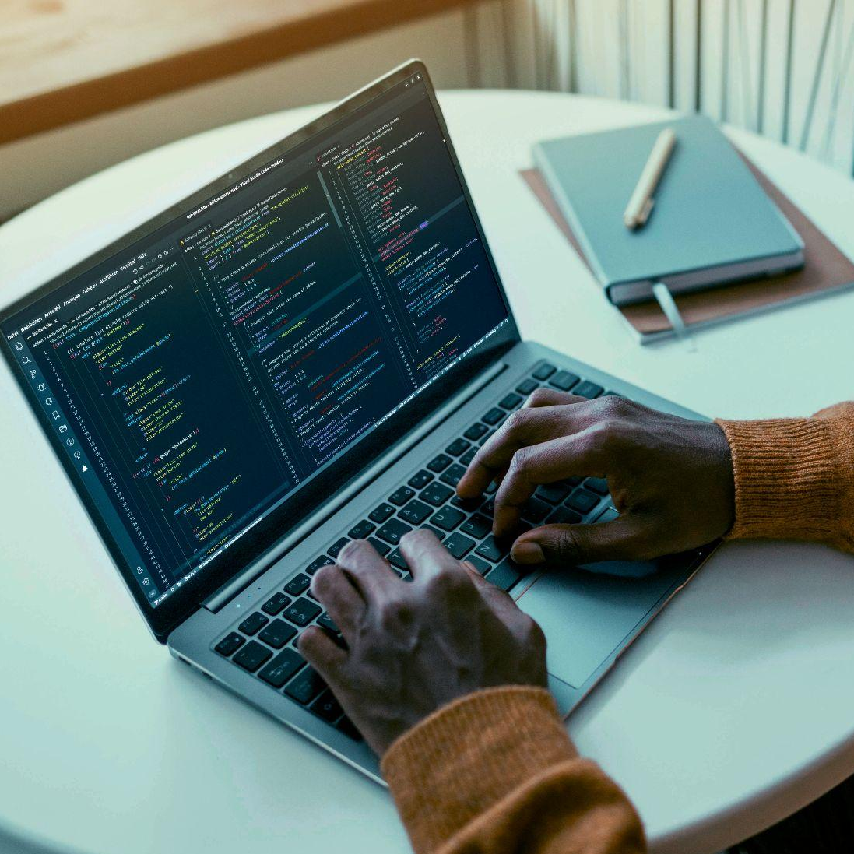
Project Overview
This project focuses on developing a mobile application that captures, stabilizes, and smooths virtual hand movements for patients with Parkinson’s disease, specifically for virtual writing.
Key features of this project include:
Gesture tracking and stabilization
Machine Learning for Gesture Smoothing
VR/AR Integration

Slide 4
Functionality List
LED Gloves
Mobile Application
Image Processing
Stack: Kotlin, Android Studio
User draws in front of camera, app sends to other modules, and returns smoothed writing
Language: C
Hardware: Arduino Nano
Controls brightness of gloves using PWM
Tech: Camera 2 API, OpenCV, Kalman Filter
Reduces noise, processes input into 4D array for ML
Machine Learning
3D Visualization
AR/VR
Tech: CNN-LSTM model, Pytorch
Smooths out writing further
Tech: OpenGL ES
Visualizes the output from the ML module in 3D
Users can interact with the application in AR/VR mode

Slide 5
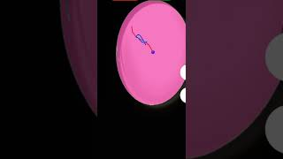
Recorded Demo
Red Line : Raw Data
Green Line: Smoothed Data (Kalman + Mov Avg)
Blue Line: Visually Smoothed Data (Spline)

Slide 6
THANK YOU!
Do you have any questions?

